Slide 1
V3D1
WEEK 2a
Lights, lighting calculations
Colors

Slide 2
Light sources and colors
There are 3 types of light sources:
  Pointlight, spotlight, directional light
Light sources have 3 types of colors
  Diffuse color, specular color, and ambient color
Objects have 4 types of colors:
  Diffuse color, specular color, ambient color and emissive color
The final color is a combination of all the above

Slide 3
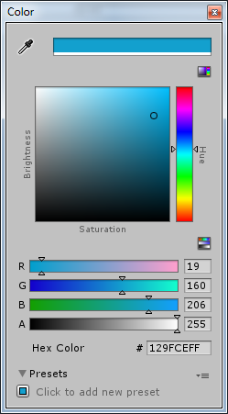
How do we define a color?
On a screen, colors are a combination of Red, Green and Blue (RGB)
  Each color has a range of 0…1 or from 0…255
    Vizard uses 0…1
    Unity is not completely consistent
  Examples:
    (0,0,0)
    (1,0,0)
    (1,1,0)
    (1,1,1)
  Color editor

Slide 4
Pointlight (1)
Pointlight
  Light from 1 point
  The light itself is not visible
  No shadow
  Light weakens with distance
  Models artificial light (light bulb)

Slide 5
Pointlight (2)
Properties
  Colors
    Ambient, diffuse, specular
  Position
  Attenuation
    Constant attenuation (ca, default 1),
    Linear attenuation (la, default 0),
    Quadratic attenuation (qa, default 0)
    light value = 1/(ca + la*distance + qa*distance²)

Slide 6
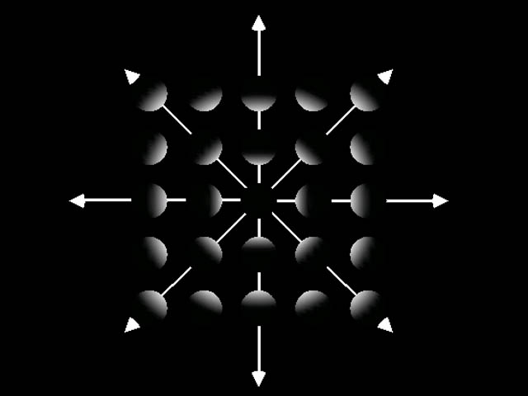
Pointlight (3)

Slide 7
Spotlight (1)
Spotlight
  As pointlight, but
  only inside certain cone
Properties
    Same as pointlight, and also
    Direction
    Angle between center and side, spread
    Difference in intensity between center and side: concentration, spot exponent
  A pointlight is in fact a spotlight with a spread of 180 and concentration of 0

Slide 8
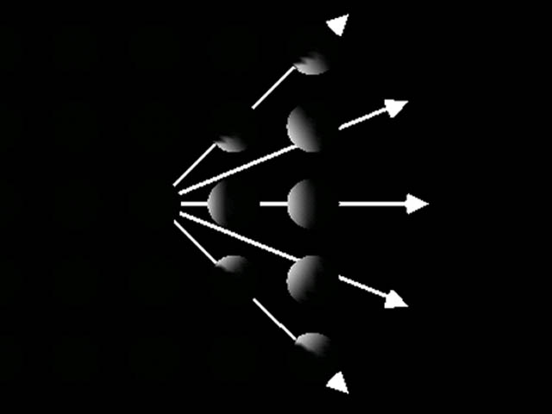
Spotlight (2)

Slide 9
Directional light (1)
Directional light
  From infinitely far away, no position
  No attenuation
  Models incoming sunlight
Properties
  Colors
  Direction
    Direction is defined with w=0:
      (0,1,0,0) means
        light has the direction from (0,1,0) to (0,0,0)

Slide 10
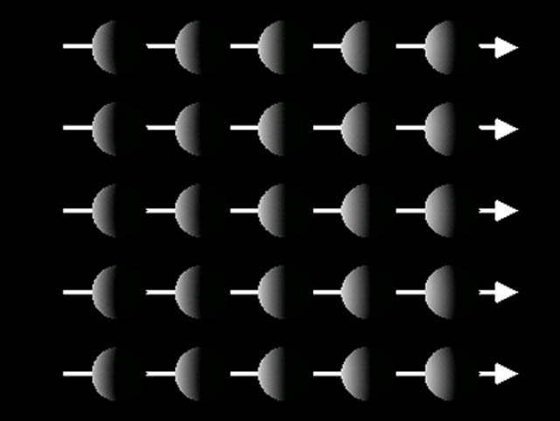
Directional light (2)

Slide 11
Light sources
Usually only 8 light sources can exist at one time
  Numbered from 0 to 7
  Properties can be defined for each light source separately as explained before
  Each light source can be
    enabled or disabled (on or off)
    moved and rotated, when applicable
      Directional light can not be moved because it has no position
      Pointlight can not be rotated because it has no direction
Usually, there is a global ambient light (0.2,0.2,0.2)

Slide 12
Lights in Vizard
Vizard has a default headlight at the viewer position
  viz.MainView.getHeadLight()
Vizard has a default ambient light (0.2,0.2,0.2)
A new light is by default directional, shining in z-direction
A light can be positioned in 2 ways:
  setPosition: will move the light to the specified position
  position: changes the local origin of the light
    here, we also define directional/pointlight with w

Slide 13
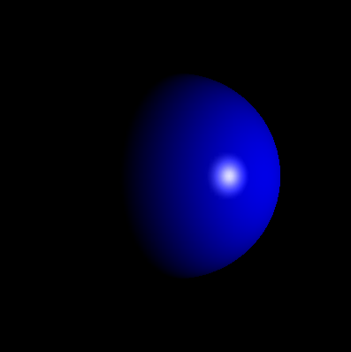
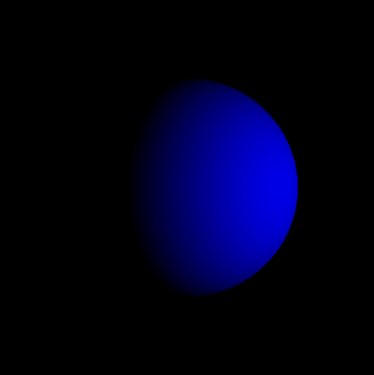
Colors of light sources (1)
Diffuse color:
  A color that is reflected in all directions on an object
  Give ‘matted' effect
Specular color:
  Color that is mainly reflected on the normal
  Gives a mirroring effect

Slide 14
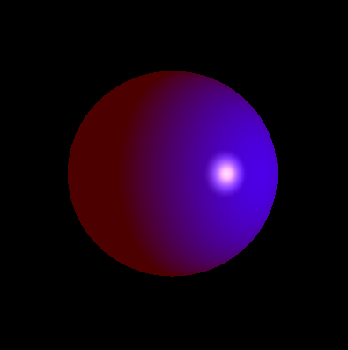
Colors of light sources (2)
Ambient color:
  Models ‘all around' daylight; light that is reflected on other objects
  Makes ‘backsides' also visible

Slide 15
Material properties
We discussed the light sources, which can be defined and positioned independently of objects
Now we will discuss colors that can be given to an object, sometimes combined in the word ‘material’
  Material colors can sometimes be set for front faces and back faces separately

Slide 16
Diffuse color
Diffuse color, or matted color, or just ‘color’
  The main color of an object
  Matted color, without reflection
  Interacts with diffuse color of a light source

Slide 17
Specular color
Specular color
  Color of that part of the object that reflects the light source (highlight)
  Interacts with specular color of a light source
Shininess 0..128
  Factor that defines the level of reflectiveness
  Effect is visible as the size of the highlight
    High Shininess → small highlight (seems mirrorlike)
    Low Shininess → big highlight (seems matted)

Slide 18
Emissive and ambient color
Ambient color
  Interacts with ambient color of a light source
Emissive color
  This color is always visible, also without light source
  Example: fluorescent objects (hands of an alarm clock)
  Interacts with no light source

Slide 19
Overview
Point Light
Diffuse Color
Spot Light
Light
Specular Color
Directional Light
Ambient Color
Interaction
Diffuse Color
Specular Color
Shininess
Object
Ambient Color
Emissive Color

Slide 20
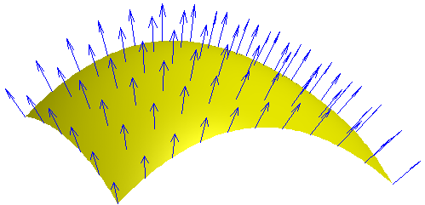
Normal
In order to show the effect of light sources, material colors and shininess, ‘surface normals’ are needed
A surface normal (‘normal vector’, or shortly ‘normal’) is a vector that
  is perpendicular to the surface of the object
  is pointing outwards
  has length 1

Slide 21
Defining normals in Vizard (1)
Use viz.normal before viz.vertex:
  viz.startLayer(viz.POLYGON)
  viz.normal(0,0,-1)
  viz.vertex(0.5,1,10)
  viz.normal(0,0,-1)
  viz.vertex(1.5,1,10)
  viz.normal(0,0,-1)
  viz.vertex(1.5,-1,10)
  viz.normal(0,0,-1)
  viz.vertex(0.5,-1,10)
  myPoints = viz.endLayer()

Slide 22
Defining normals in Vizard (2)
If all normals in a polygon are the same, use viz.normal only once:
  viz.startLayer(viz.POLYGON)
  viz.normal(0,0,-1)
  viz.vertex(0.5,1,10)
  viz.vertex(1.5,1,10)
  viz.vertex(1.5,-1,10)
  viz.vertex(0.5,-1,10)
  myPoints = viz.endLayer()

Slide 23
Defining normals in Unity
In Unity, for each object we define a list of vertices (in random order), and a list of indices that define the triangles
Example:
  vertices: [(0,0,0), (1,0,0), (1,1,0), (0,1,0)]
  triangles: [0, 1, 2, 0, 2, 3]
For each vertex in
array vertices,
we define the normal
in array normals
3
2
0
1

Slide 24
Lighting calculations: ambient
Formula for ambient color:
  C_{a} = M_{a} * L_{a}
  In words: actual ambient color (C_{a}) is the product of material ambient color (M_{a}) and light source ambient color (L_{a})
Consequences:
  Normal is irrelevant
  Position of viewer is irrelevant

Slide 25
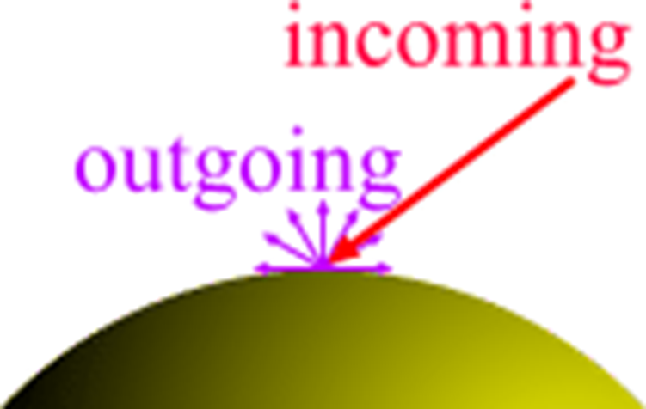
Lighting calculations: diffuse
Formula for diffuse color:
  C_{d} = M_{d} * L_{d} * (n.l)
  In words: like ambient color, but
  multiplied by the dot product
  of the vertex normal n and the vector to the light l
  This also has to be multiplied by the attenuation factor
Consequences:
  Actual color depends on normal
    Color is brighter when light source
    is closer to normal
  Position of viewer is irrelevant

Slide 26
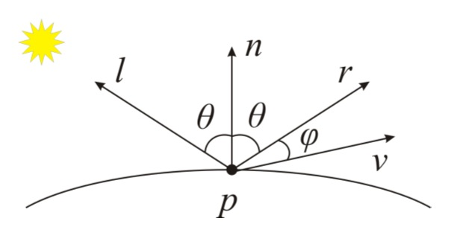
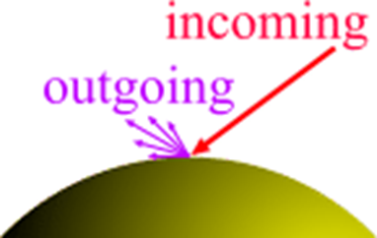
Lighting calculations: specular
Formula for specular color:
  C_{s} = M_{s} * L_{s} * (r.v)^{sh}
  In words: like ambient color,
  but multiplied by the dot
  product of the reflected light vector r and the vector to the viewer v, to the power shininess sh
Consequences:
  Actual color depends on normal,
  light source position and viewer
  position
    Color is brighter when viewer is
    closer to reflected lightbeam

Slide 27
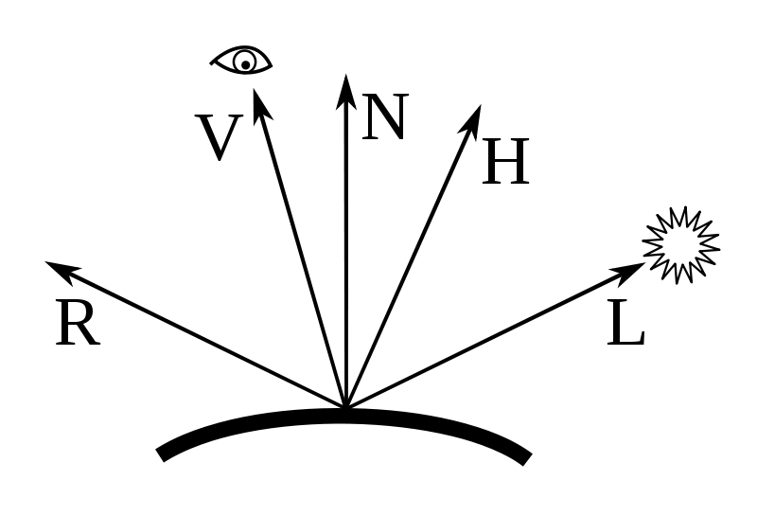
Alternative specular calculation
Alternative formula for specular color (Blinn–Phong):
  C_{s} = M_{s} * L_{s} * (n.h)^{sh}
  where h is the normalized vector halfway between L and V

